Slide 1
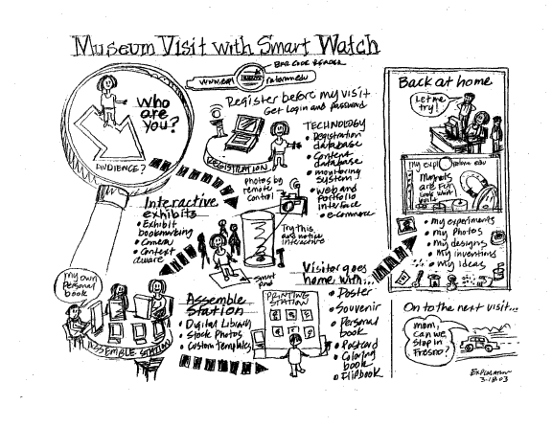
Sketching & Storyboarding CSCI 5839– Fall 2014
Notes:
http://what-the-fail.com/computer-user-fail/

Slide 2
Assignments etc.
Due Thursday: peer feedback on P1
Next Thursday: personas, scenarios, sketches
Notes:
Open ended is part of the class, graduate class. So if you want feedback don’t hesitate to ask me or TAs

Slide 3
Sketching

Slide 4
Sketching
Why sketch
Tips on sketching
Storyboarding

Slide 5
What is sketching?
Representing early ideas outside of your brain
Many forms: block diagrams, drawings, storyboards, text
Early ideas at a level of detail that is easy to work with

Slide 6
Why sketch
Capture ideas before you forget them
Feed the creative part of your brain
Try out ideas quickly (and discard bad ones)
Prevent yourself from getting distracted by details

Slide 7
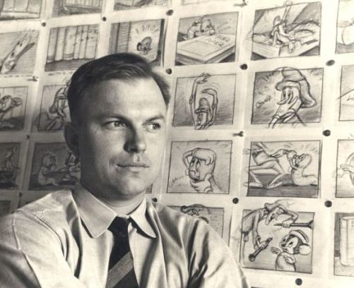
“The whole essence of good drawing – and of good thinking, perhaps – is to work a subject down to the simplest form possible and still have it believable for what it is meant to be.”
–Chuck Jones

Slide 8
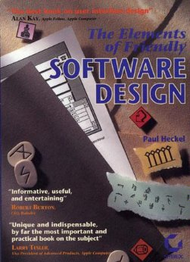
“If Ernest Hemingway, James Mitchener, Neil Simon, Frank Lloyd Wright, and Pablo Picasso could not get it right the first time, what makes you think that you will?“
— Paul Heckel

Slide 9
Myths about sketching
I can’t sketch!
I need to be an artist to sketch
I’ll save time by going straight to my dev environment

Slide 11
Sketching tools
Skitch: http://evernote.com/skitch/
Balsamiq: http://balsamiq.com/
Many apps, e.g. Paper http://www.fiftythree.com/paper

Slide 12
Sketching tools
Skitch: http://evernote.com/skitch/
Balsamiq: http://balsamiq.com/
Many apps, e.g. Paper http://www.fiftythree.com/paper
But really, start with paper
(get fancy notebooks/pens if it helps)

Slide 13
Sketching process
Divergent sketching
Explore possible ideas
Convergent sketching
Get the details right
Iterative process

Slide 14
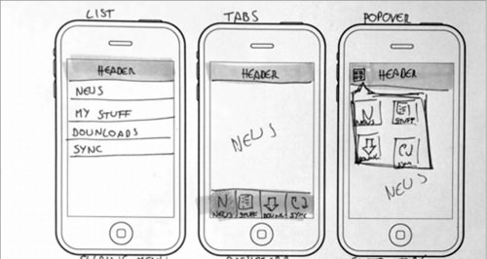
Divergent sketching
Notes:
No one should ever say, at this stage, whoa, that idea is TOO different

Slide 15
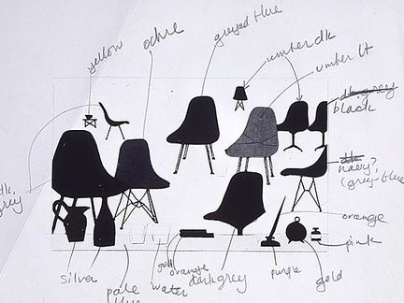
Convergent sketching
Charles Eames (dwr.com)

Slide 16

Sketching physical objects
Jeff Hawkins’ (Palm) block of wood
Notes:
Physical prototyping
http://idintern.wordpress.com/2011/02/03/business-realities/s

Slide 17
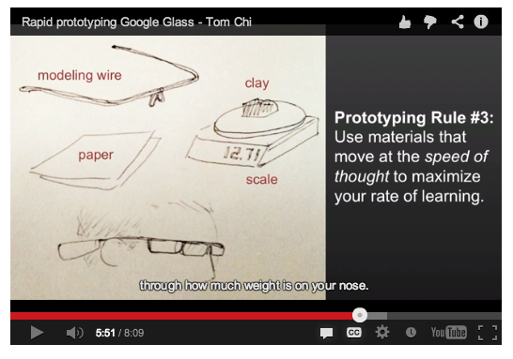
Google Glass in chopsticks
http://glass-apps.org/google-glass-prototype

Slide 18
Tips for sketching
Make LOTS of sketches
Hang them on the wall
Sketch neatly, so you can go back to your sketches later (and share them)
OK to take shortcuts (trace images, reuse elements across sketches)

Slide 19

Star people
Notes:
http://brylie.gnumedia.org/storyboarding/
Why are star people better than stick people?

Slide 20
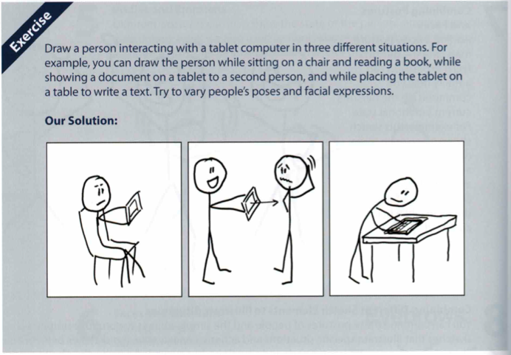
Activity
your app
Notes:
10 minutes

Slide 21
Storyboarding

Slide 22
Storyboarding
A “rough draft” of a visual, sequential story
Like a comic book
Focus on visual storytelling
What’s going on?
What do I need to show?
What are the transitions?
What are the major “beats” of the story?
Notes:
Videos
Movies
UI

Slide 23
What storyboarding is good for
Tell a story (or describe a usage scenario)
Can get useful feedback
Identify the main steps of the interaction
Identifies potential problems
Do tasks need to happen in a certain order?
Where are the user’s hands/eyes/attention?

Slide 24
Storyboarding process
Start with your scenario
divide it into sentences
Put each sentence in an empty box
Number each box
Write the sentence from the scenario below each box
Consider splitting frame into two parts

Slide 25
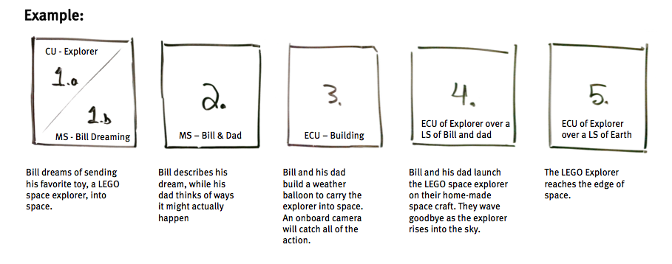
AC4D design library http://library.ac4d.com/

Slide 26
Storyboarding process
3. Start designing the scene
Who is in the scene?
What is the minimal amount of content you need to convey the scene?
What kind of “shot is it”?
Closeup (CU)
Over the shoulder (OTS)
Extreme closeup (ECU)
Long shot (LS)
Medium shot (MS)
AC4D design library

Slide 27
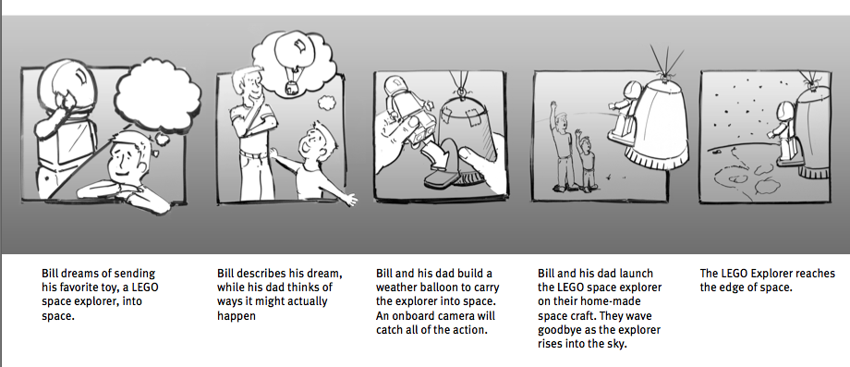
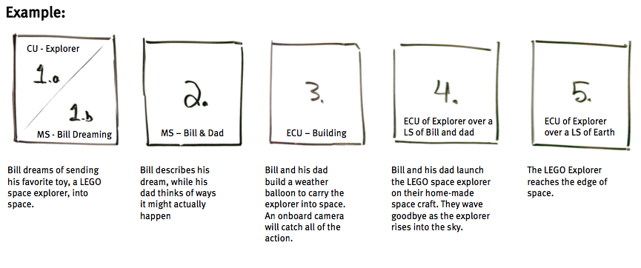
AC4D design library

Slide 28
Storyboarding process
Sketch what happens in the scene inside each box
Emphasize people, hands and eyes
If there are screens, first show the context, then fill in the screen
Start with stick/star figures, detailed sketches aren’t necessary
AC4D design library

Slide 29
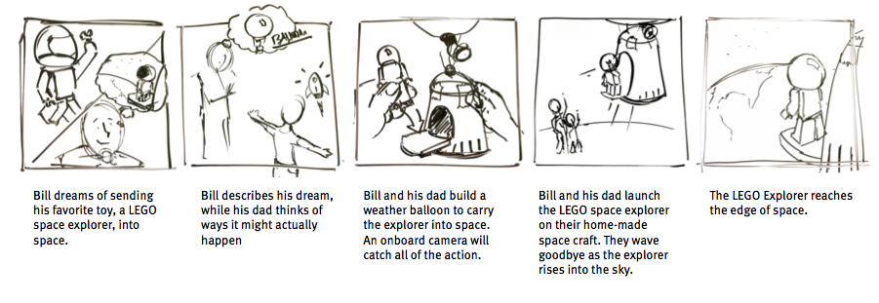
AC4D design library

Slide 30
Notes on storyboarding
Keep the camera view in mind
How much detail can the user see?
Where is the camera?
Are transitions clear?
Show, don’t tell
Choose the right level of detail

Slide 31
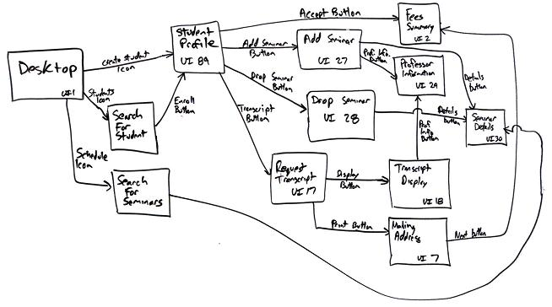
Flow diagrams vs. storyboards
Notes:
http://www.agilemodeling.com/artifacts/uiFlowDiagram.htm

Slide 32
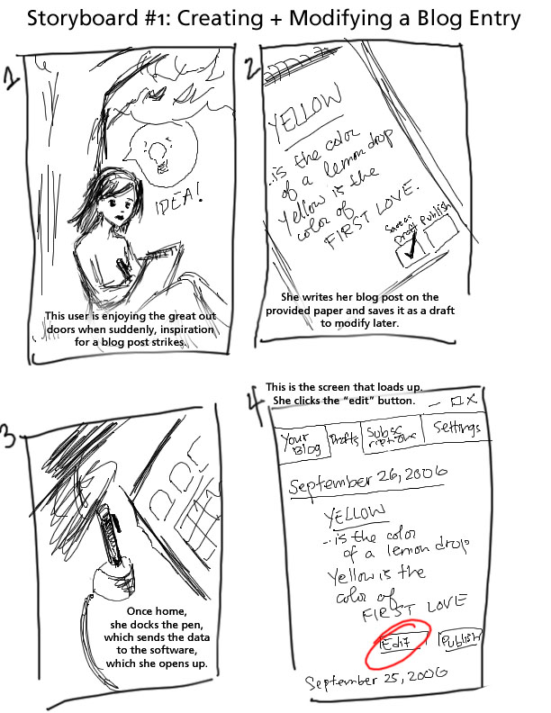
Notes:
http://vis.berkeley.edu/courses/cs160-fa06/wiki/index.php/InteractivePrototype-Group:4Corners

Slide 33
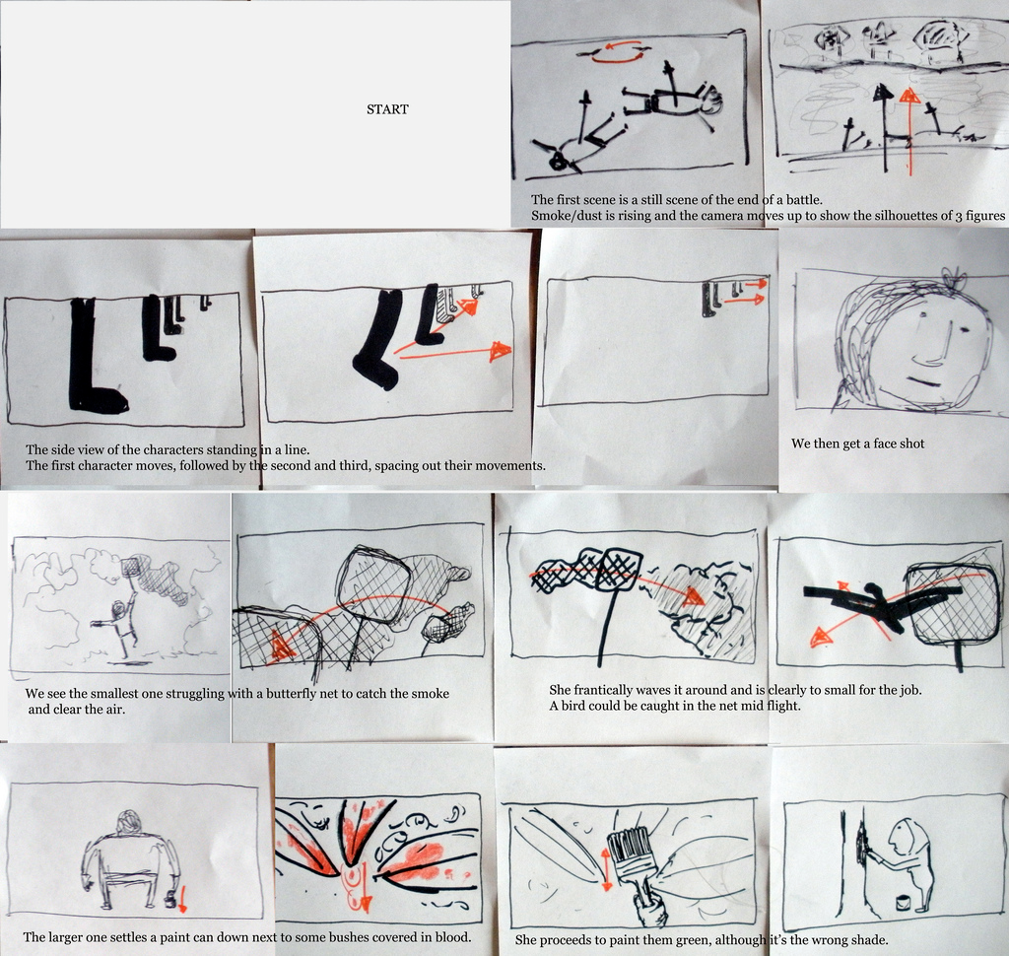
Notes:
http://alecchalmers.blogspot.com/2008/11/storyboards.html

Slide 34
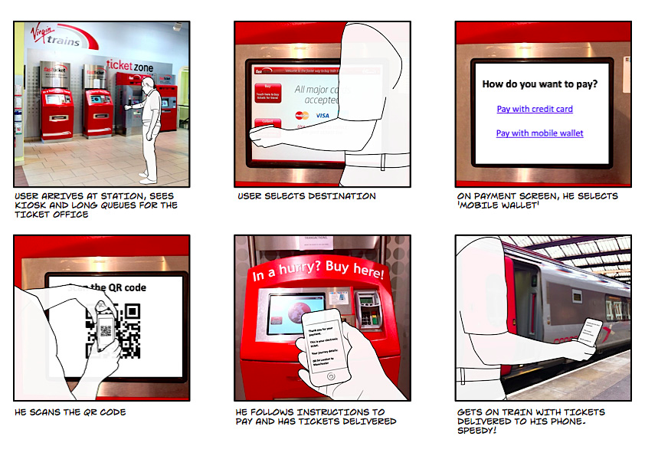
Notes:
http://www.userfocus.co.uk/

Slide 35
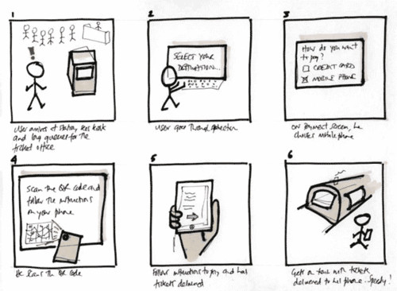
Notes:
http://vi.sualize.us/storyboard_of_a_ticket_purchase_process_storyboards_ui_sketch_picture_vXUu.html

Slide 36
Interactive demo
Let’s make a storyboard together

Slide 37
Make your own storyboard
In groups of 2, make a storyboard documenting one of your app’s scenarios
For simplicity, stick with 6 panels

